Slide 1




Mixed Reality User Group
Remote aSSets in windows mixed reality
Joost van schaik
Developer++ @ Wortell
TWITTER #MIXUG003

Slide 2

Remote aSSets in windows mixed reality
Joost van Schaik
Wortell

Slide 3
What?
Loading (JSON) data from data services
Loading remote images
Preparing and loading remote audio
Preparing and loading remote video
Preparing and loading remote Holograms

Slide 4
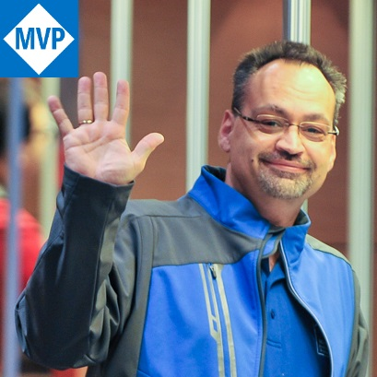
Who?
Joost van Schaik
Lead HoloLens / Business Apps developer @ Wortell
Microsoft Windows Development MVP
25 yr experience, 22 yr Geo-ICT
Developer++
Twitter, blog
Tinkerer, rogue R&D hacker
“Willie Wortel” (‘Gyro Gearloose’)

Slide 5

Where?
@localjoost
joostvanschaik@outlook.com
joost.van.schaik@wortell.nl
linkedin.com/in/joostvanschaik
dotnetbyexample.blogspot.com

Slide 6

Wortell?
Digital transformation
Work everywhere (Office365)
Always the bleeding edge
Cloud cloud cloud (did I mention cloud?)
Microsoft
Application development
Markets:
Care
Construction
Large infrastructural corporations (NS, Schiphol)

Slide 7



Slide 8
Why?
Dynamic content
Real time info
Subsets of large datasets
Content update without app update

Slide 9
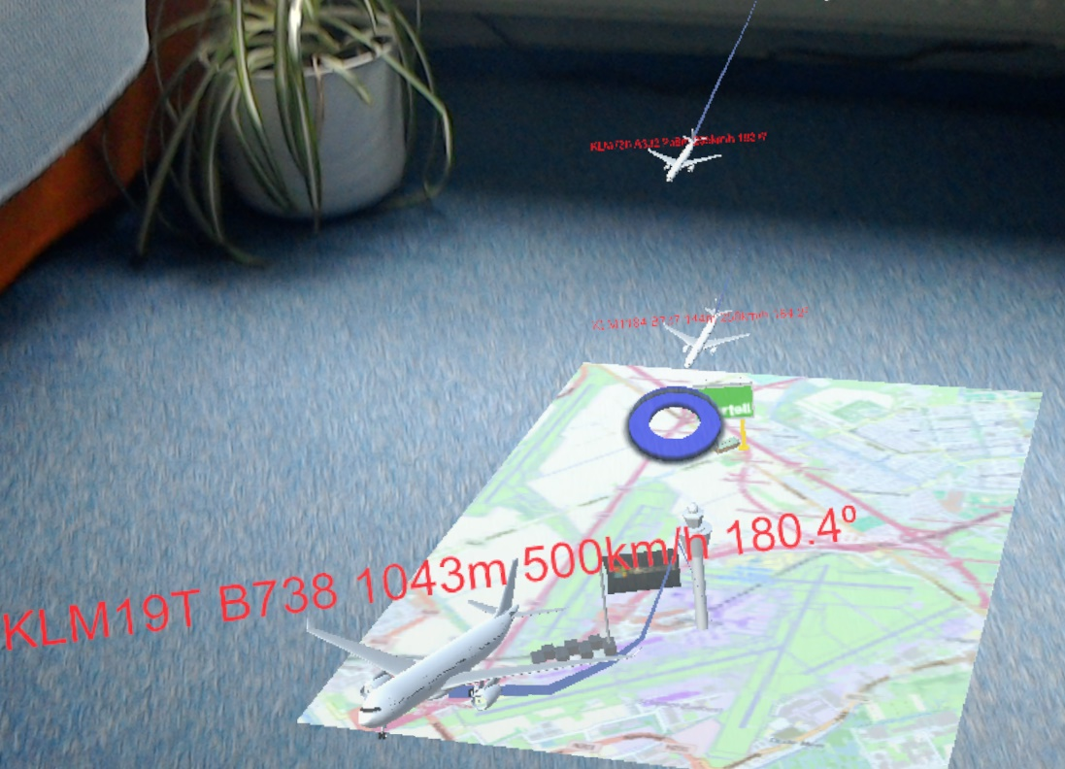
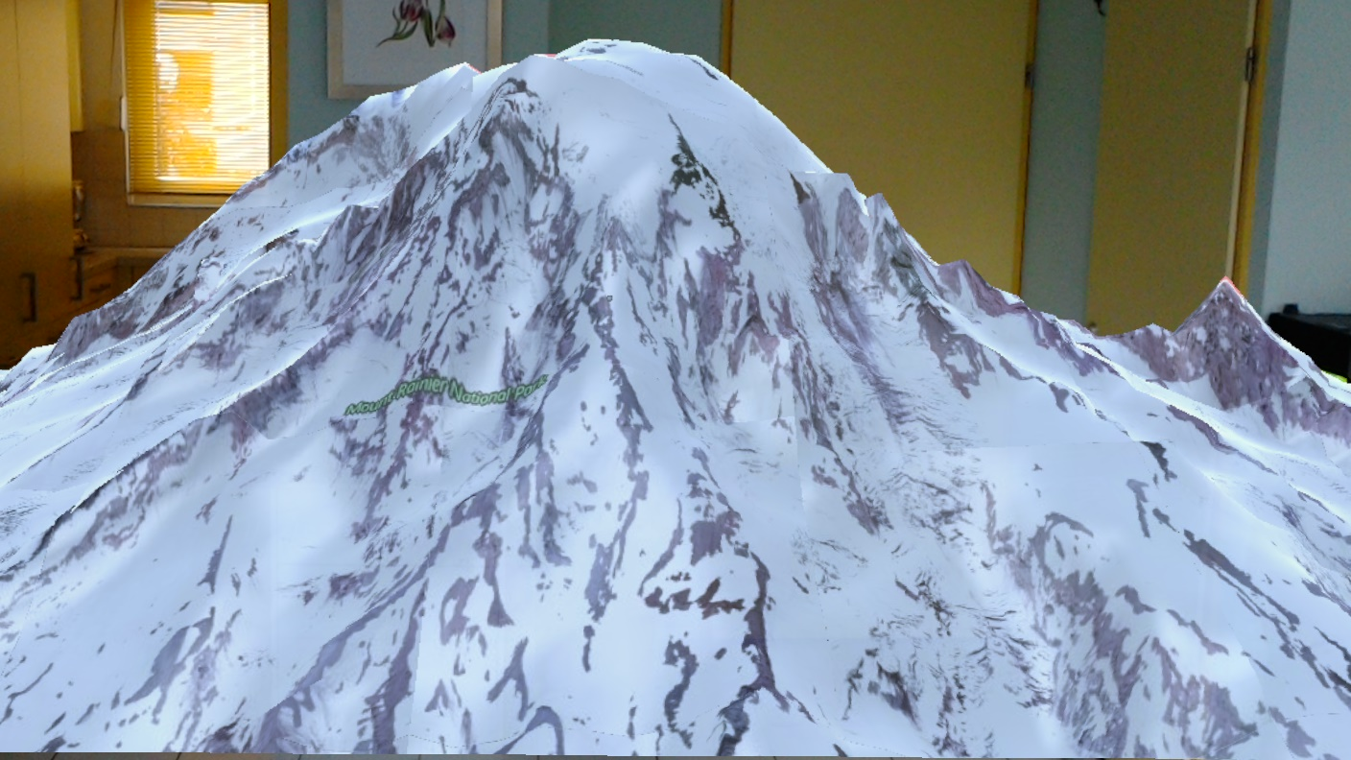
Examples

Slide 10

Data services

Slide 11
DataServices
‘Ordinary’ JSON services downloading ‘some’ data
MR apps constructs 3D content based upon data

Slide 12
3 methods
WWW (deprecated)
UnityWebRequest
Pure UWP (HttpClient/HttpRequestMessage)

Slide 13
UnityWebRequest
Uses handlers
Integrates with Unity, easy conversion JSON->Data objects
Works in editor (easier testing)

Slide 14
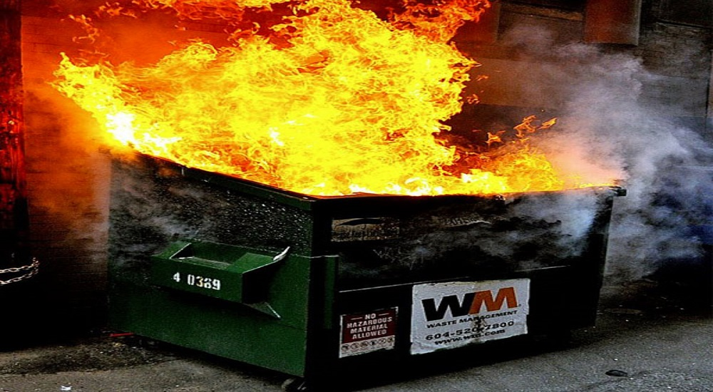
Demo – Data SErvices

Slide 15
Recap
UnityWebRequest
ZUMO-API-VERSION", "2.0.0”
request.downloadHandler.text -> default handler
JsonConvert.DeserializeObject (!!)

Slide 16
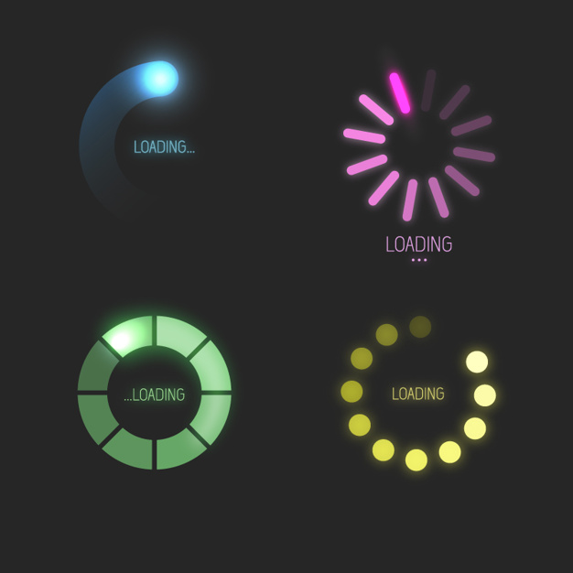
Loading Images

Slide 17
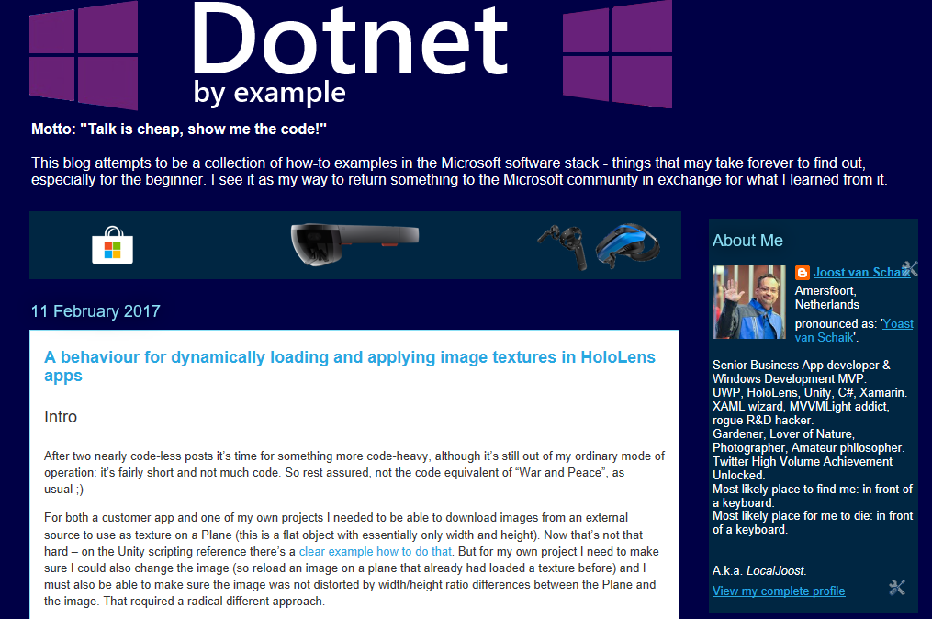
Nope!

Slide 18
Downloading images:
Use a plane
Rotate plane 90°/90°/270°
Download the image
Set plane renderer’s texture material to downloaded image

Slide 19
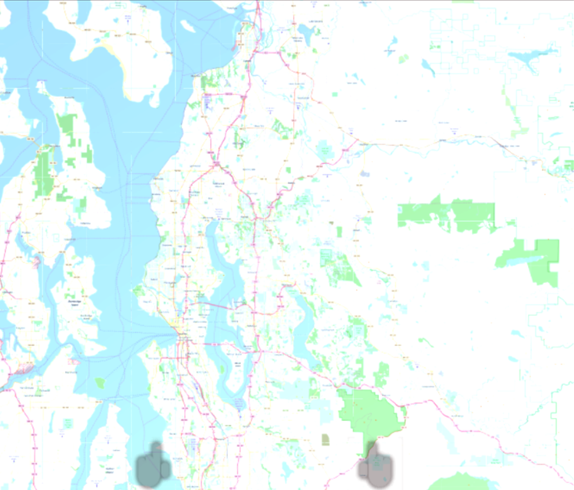
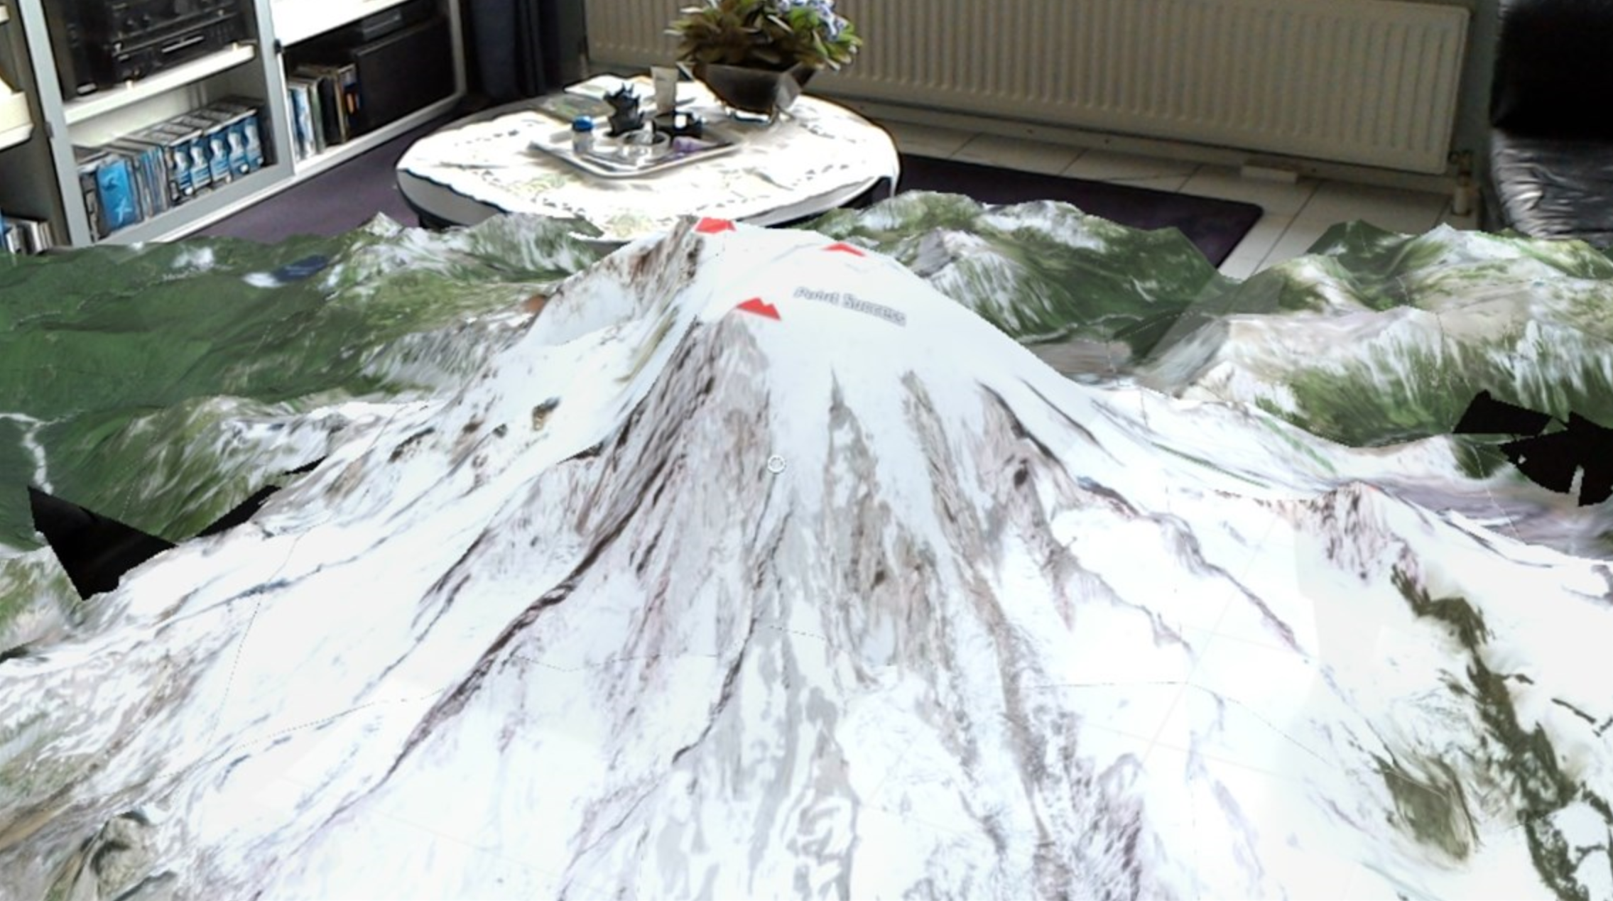

Slide 20

AUDIO FILES

Slide 21
Tools
Audacity
convert to .ogg
Azure portal
Create Storage Account
Microsoft Azure Storage Explorer
Create Blob container
Upload .ogg to blob
Get shared access signature url

Slide 22
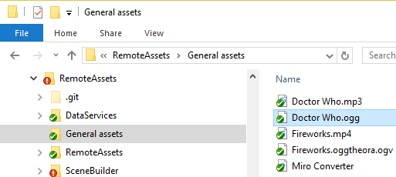
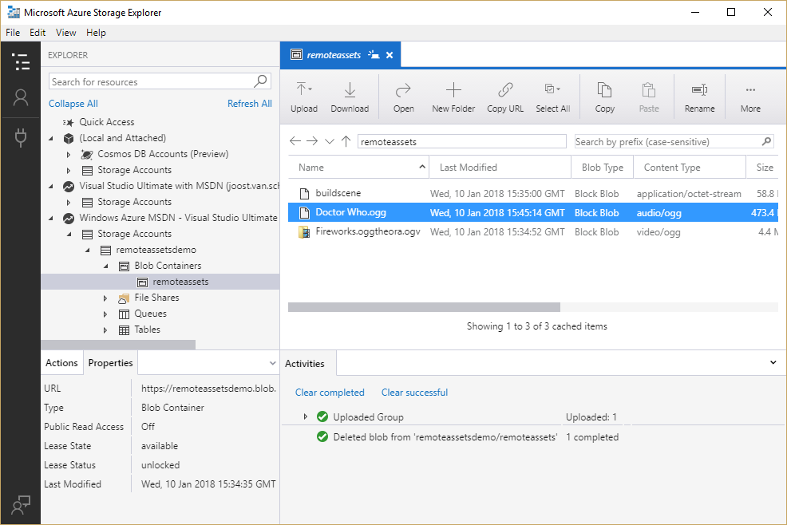
Upload

Slide 23
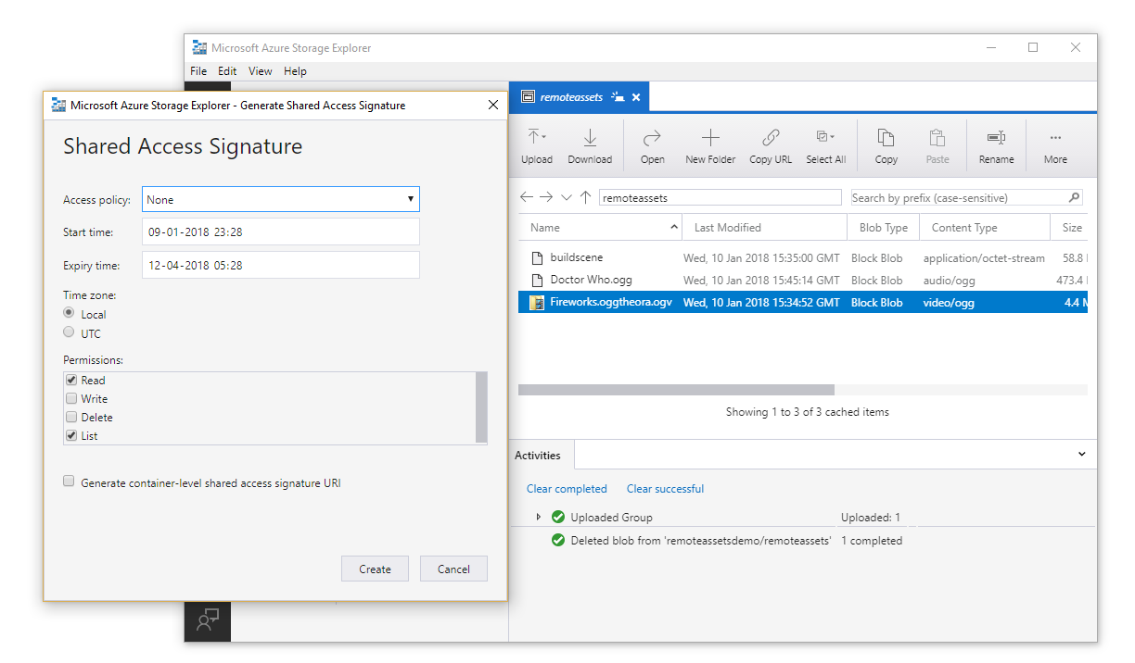
Shared Access Signature

Slide 24
Global approach
Use UnityWebRequest
Use DownloadHandlerAudioClip
AudioSource.clip = handler.audioClip

Slide 25

Demo – Audio clip
(with controls)

Slide 26
Recap
Use UnityWebRequest
Use DownloadHandlerAudioClip -> AudioType.OGGVORBIS
AudioSource.clip = handler.audioClip
AudioSource.clip.length
AudioSource.Play, Pause, Stop
Floating button and slider from MRTK-examples
IconToggler

Slide 27

VIDEO

Slide 28
Tools
FFmpeg (https://ffmpeg.zeranoe.com/builds/)
convert to oggtheora (.ogv)
Azure portal
Create Storage Account
Microsoft Azure Storage Explorer
Create Blob container
Upload ogv to blob
Get shared access signature url

Slide 29
Global approach
Use a plane
Rotate plane 90°/90°/270°
Use UnityWebRequest
Use DownloadHandlerMovieTexture Set plane renderer’s texture material to downloaded movie texture
AudioSource.clip to movie texture audio clip

Slide 30
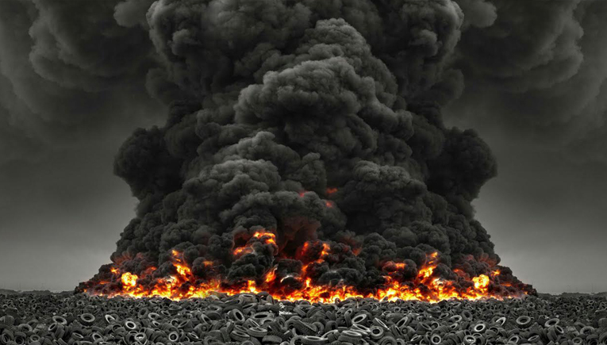
Demo – Video with Audio
(And look-at-controlling)

Slide 31
Recap
UnityWebRequest
DownloadHandlerMovieTexture GetComponent<Renderer>().material.mainTexture = handler.movieTexture
AudioSource.clip = handler.movieTexture.audioClip
movieTexture.Play, Pause – no stop, no time setting
Play by looking, pause by not looking (after timeout)
Consider size/quality

Slide 32
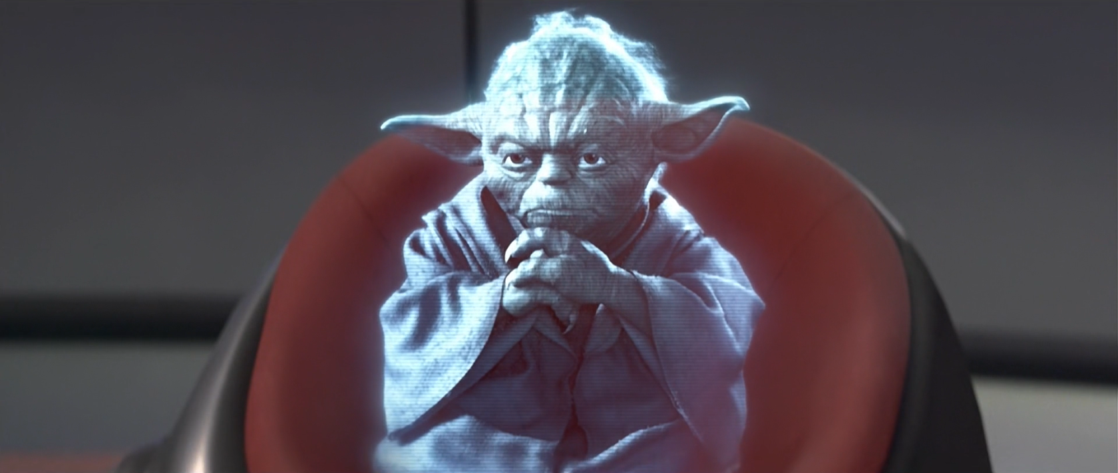
REMOTE HOLOGRAMS

Slide 33
Global approach
Build an “Asset Bundle” of a scene (or something else)
Upload to Azure blob
Download scene or other asset
Process

Slide 34
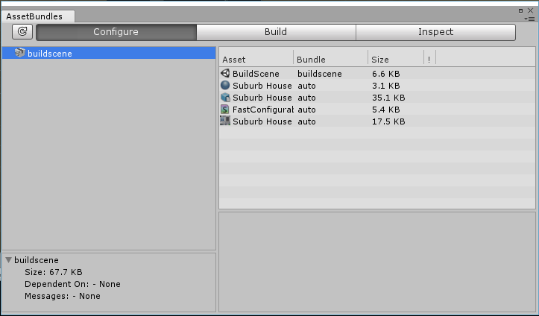
Building an Asset Bundle (1)
AssetBundle Browser
https://github.com/Unity-Technologies/AssetBundles-Browser
Window/AssetBundle Browser

Slide 35
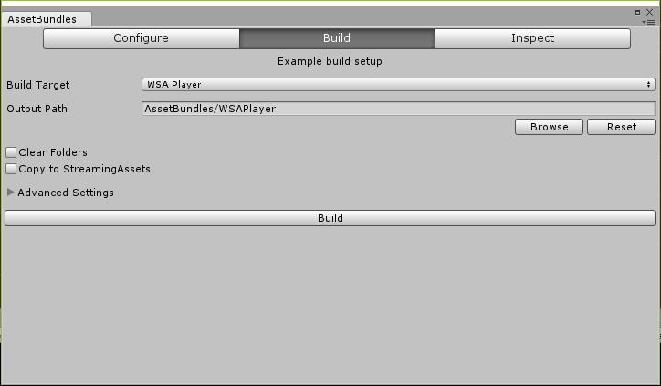
Building an Asset Bundle (2)
Empty scene, only the stuff you want
BUILD THE APP FIRST
Drag assets in Left tab
Check Build tab
Select “WSA Player”
Hit the big Build button

Slide 36
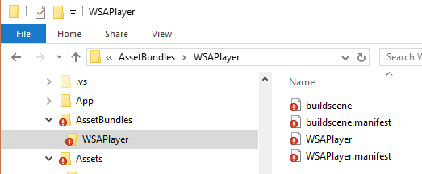
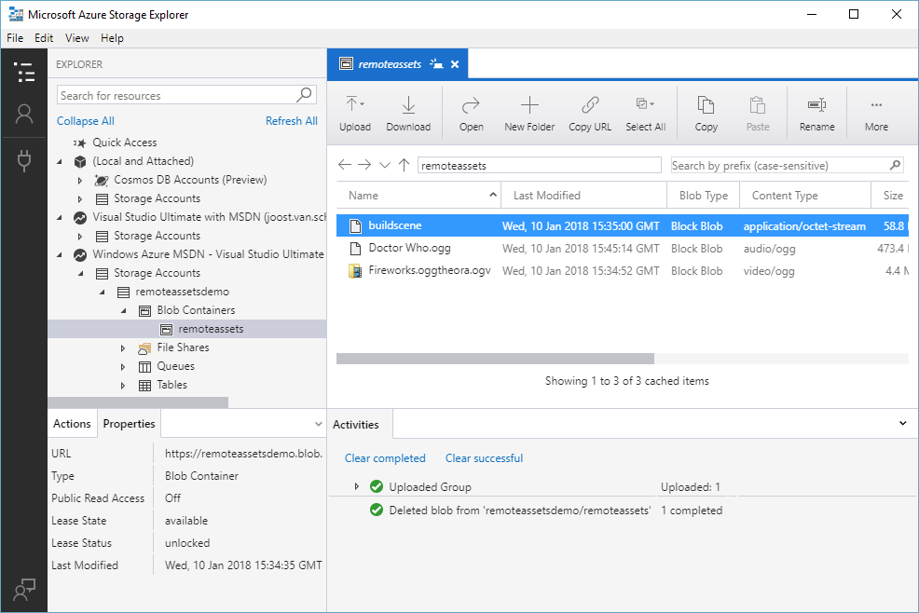
Upload to Azure, SAS

Slide 37
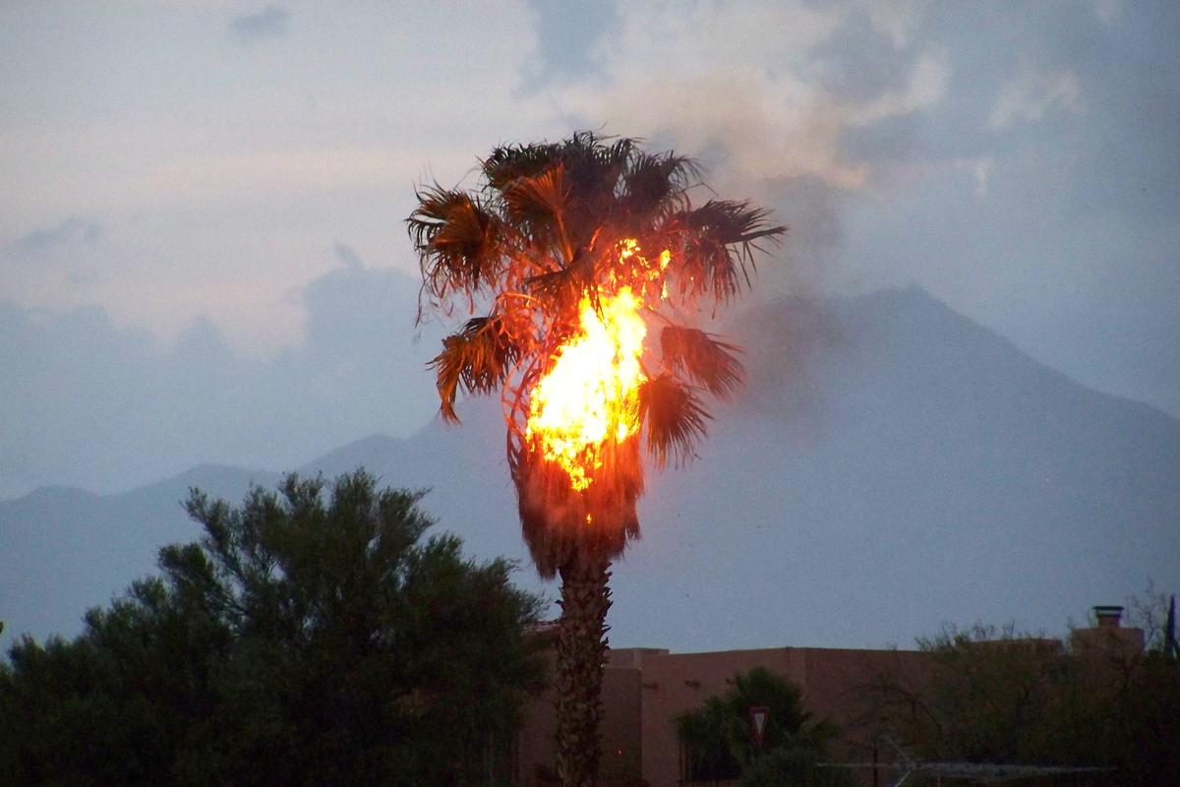
Demo – Building/Uploading Unity Assets

Slide 38
Recap
Sparse scene
Build app
Window/AssetBundle Browser
Select WSA Player
Build
Upload asset bundle to Azure
SAS

Slide 39
USING an Asset Bundle
UnityWebRequest
DownloadHandlerAssetBundle
DownloadHandlerAssetBundle.GetAllScenePaths()
SceneManager.LoadSceneAsync() - > Additive

Slide 40

Demo – DoWnloading/showing Unity Assets

Slide 41
Recap
DownloadHandlerAssetBundle
SceneManager.LoadSceneAsync
Fishing loaded stuff from additive scene
or
bundle.LoadAsset<T>
Instatiate prefab

Slide 42
Stuff you can put in Asset Bundles
Scenes
Audio
Video
Prefabs
Materials
Shaders
Text files
Basically any asset – but NO SCRIPTS

Slide 43
Thoughts/warnings
Any code referenced MUST BE IN TARGET PROJECT
Beware of version issues
ALWAYS ALWAYS TEST
Still need to prepare the models in Unity
Local caching

Slide 44


Slide 45

The END

Slide 46
INNOVATE TO LEAD

Slide 47
Who again?
@localjoost
joostvanschaik@outlook.com
joost.van.schaik@wortell.nl
linkedin.com/in/joostvanschaik
dotnetbyexample.blogspot.com

